Slide 1
Multimedia Systems Lecture – 10
By
Dr. Priyambada Subudhi
Assistant Professor
IIIT Sri City

Slide 2
JPEG
The most important current standard for image compression is JPEG.
This standard was created by a working group of the International Organization for Standardization (ISO) that was informally called the Joint Photographic Experts Group and is therefore so named.
The human vision system has some specific limitations, which JPEG takes advantage of to achieve high rates of compression.
The eye–brain system cannot see extremely fine detail.
If many changes occur within a few pixels, we refer to that image segment as having high spatial frequency —that is, a great deal of change in (x, y) space.

Slide 3
Therefore, color information in JPEG is decimated (partially dropped, or averaged) and then small blocks of an image are represented in the spatial frequency domain (u, v), rather than in (x, y).
That is, the speed of changes in x and y is evaluated, from low to high, and a new “image” is formed by grouping the coefficients or weights of these speeds.
Weights that correspond to slow changes are then favored, using a simple trick: values are divided by some large integer and truncated. In this way, small values are zeroed out.
Since we effectively throw away a lot of information by the division and truncation step, this compression scheme is “lossy”
JPEG allows the user to set a desired level of quality, or compression ratio (input divided by output).

Slide 4
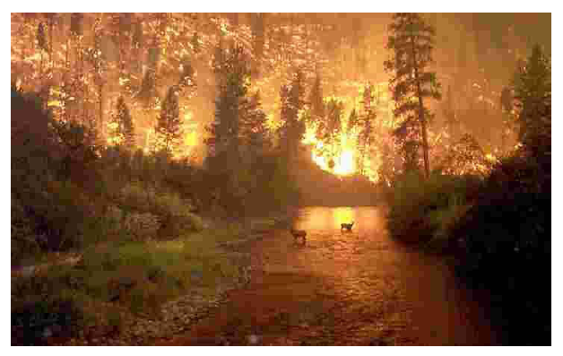
JPEG image with low quality specified by user.
This image is having a quality factor Q = 10. (The usual default quality factor is Q = 75). This image is a mere 1.5% of the original size. In comparison, a JPEG image with Q = 75 yields an image size 5.6% of the original, whereas a GIF version of this image compresses down to 23.0% of the uncompressed image size.

Slide 5
PNG
PNG format: standing for Portable Network Graphics — meant to supersede the GIF standard, and extends it in important ways.
Special features of PNG files include:
support for up to 16 bits per pixel in each color channel, i.e., 48-bit color—a large increase.
Files may contain gamma-correction information for correct display of color images, as well as alpha-channel information for such uses as control of transparency.
The display progressively displays pixels in a 2-dimensional fashion by showing a few pixels at a time over seven passes through each 8 x 8 block of an image.
It supports both lossless and lossy compression with performance better than GIF. PNG is widely supported by various web browsers and imaging software.

Slide 6
TIFF
TIFF: stands for Tagged Image File Format is another popular image file format. Developed by the Aldus Corporation in the 1980s, it was later supported by Microsoft.
The support for attachment of additional information (referred to as “tags”) provides a great deal of flexibility.
The most important tag is a format signifier: what type of compression etc. is in use in the stored image.
TIFF can store many different types of image: 1-bit, grayscale, 8-bit color, 24-bit RGB, etc.
TIFF was originally a lossless format but now a JPEG tag allows one to opt for JPEG compression.

Slide 7
EXIF
EXIF (Exchange Image File) is an image format for digital cameras.
It enables the recording of image metadata (exposure, light source/flash, white balance, type of scene, etc.) for the standardization of image exchange.
A variety of tags (many more than in TIFF) is available to facilitate higher quality printing, since information about the camera and picture-taking conditions can be stored and used, e.g., by printers for possible color-correction algorithms.
The EXIF format is incorporated in the JPEG software in most digital cameras.

Slide 8
PS and PDF
Postscript is an important language for typesetting, and many high-end printers have a Postscript interpreter built into them.
Postscript is a vector-based picture language, rather than pixel based: page element definitions are essentially in terms of vectors.
Postscript includes text as well as vector/structured graphics.
Bit-mapped images can be included in output files.
Encapsulated Postscript files (.EPS) add some additional information for inclusion of Postscript files in another document.
Postscript page description language itself does not provide compression; in fact, Postscript files are just stored as ASCII.

Slide 9
For files containing images, PDF may achieve higher compression ratios by using separate JPEG compression for the image content.
Another text + figures language has superseded or at least paralleled Postscript: Adobe Systems Inc. includes LZW compression in its Portable Document Format (PDF) file format.
PDF files that do not include images have about the same compression ratio, 2:1 or 3:1, as do files compressed with other LZW-based compression tools.
A useful feature of the Adobe Acrobat PDF reader is that it can be configured to read documents structured as linked elements, with clickable content and handy summary tree-structured link diagrams provided.

Slide 10
Some Other Image Formats
Microsoft Windows: WMF (Windows MetaFile): the native vector file format for the Microsoft Windows operating environment:
1. Consist of a collection of GDI (Graphics Device Interface) function calls, also native to the Windows environment.
2. When a WMF file is “played” (typically using the Windows PlayMetaFile() function) the described graphics is rendered.
3. WMF files are ostensibly device-independent and are unlimited in size.

Slide 11
Microsoft Windows: BMP (Bitmap image files): the major system standard graphics file format for Microsoft Windows, recognized by many programs. Watch it!: there are many sub-variants within the BMP standard.
Netpbm Format: PPM (Portable PixMap), PGM (Portable GrayMap), and PBM (Portable BitMap) belong to a family of open source Netpbm formats. These formats are mostly common in the linux/unix environments.

Slide 12
PTM
PTM (Polynomial Texture Mapping) is a technique for storing a representation of a camera scene that contains information about a set of images taken under a set of lights that each have the same spectrum (say, a xenon flash), but with each light placed at a different direction from the scene. PTM was invented at Hewlett-Packard.

Slide 13
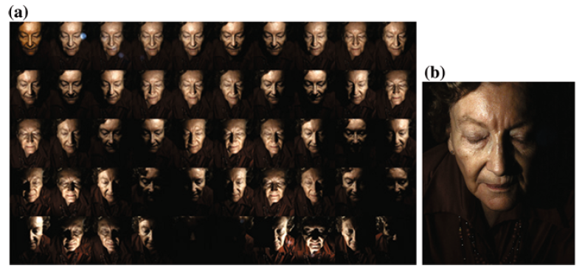
a 50 input images for PTM: lights individually from 50 different directions ei , i = 1 . . . 50; b interpolated image under new light e

